Slide 1
Leveraging Tableau & PostgreSQL for Analysis of U.S. E-Commerce Trends

Slide 2
Objective
To analyze and visualize U.S. e-commerce sales trends to identify high-performing states, seasonal sales patterns, and customer demographics, guiding strategic store setup and inventory planning.

Slide 3
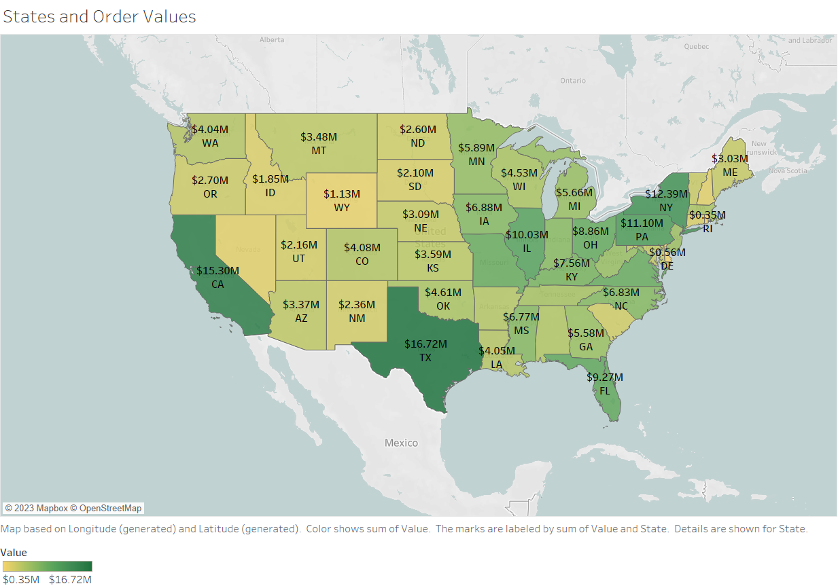
Which US State has majority of Order Values?
Texas has highest Sales value.
Sales in Texas are worth about $16.72 Million
California has second highest sales at $15.39 Million

Slide 4
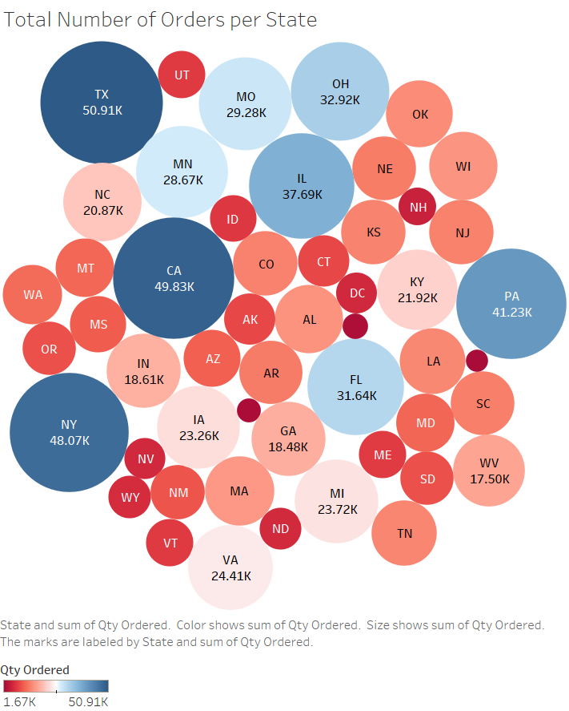
What are the top 3 US States with highest orders per month?
1 - Texas (50.91K Sales)
2 - California (49.83K Sales)
3 - New York (48.07K Sales)

Slide 5
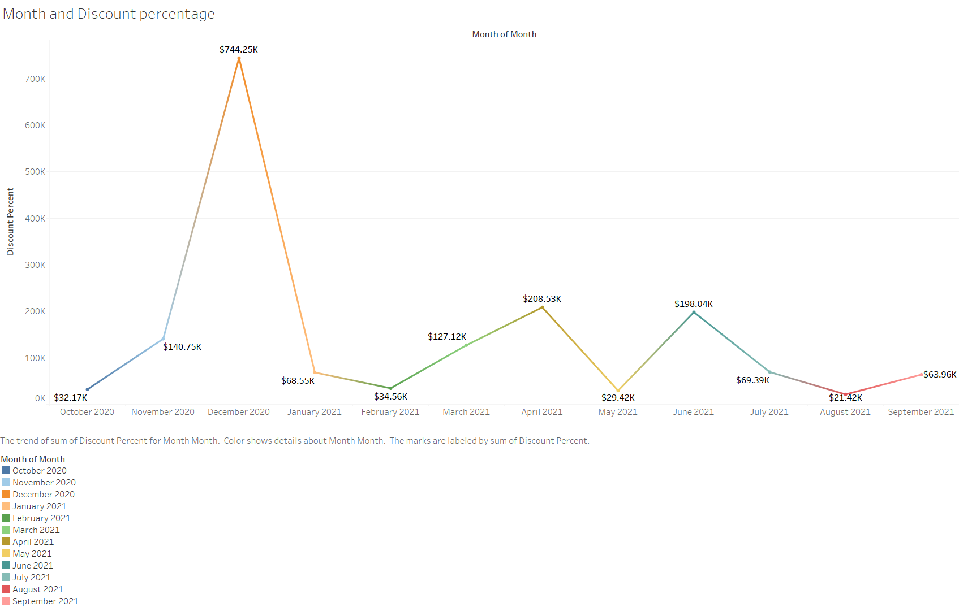
At what time of the year we can see high discounts?
Based on the visualization, the discounts start to increase from November and end in January. DECEMBER has highest discounts.

Slide 6
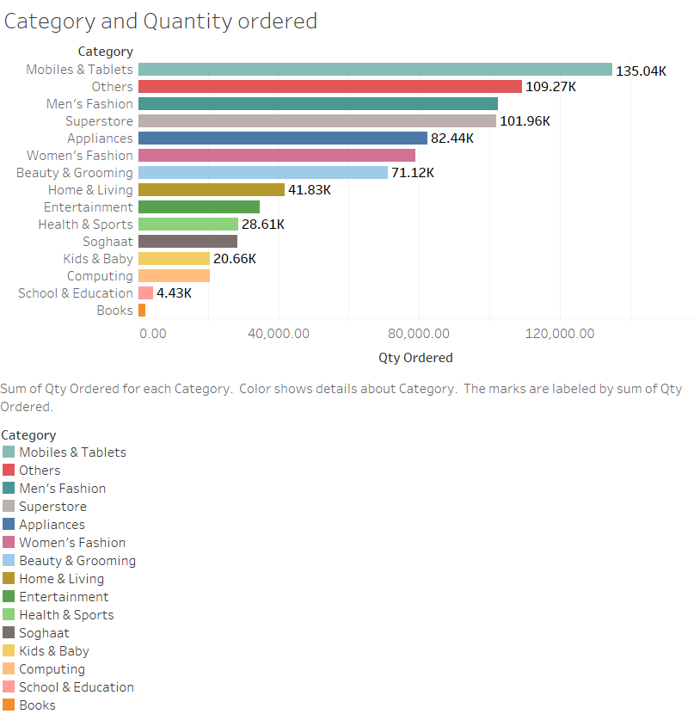
Which categories of products have high sales?
In US, Mobiles and tablets have been ordered the most.
The list is then followed by Others, Men’s Fashion and Appliances.

Slide 7
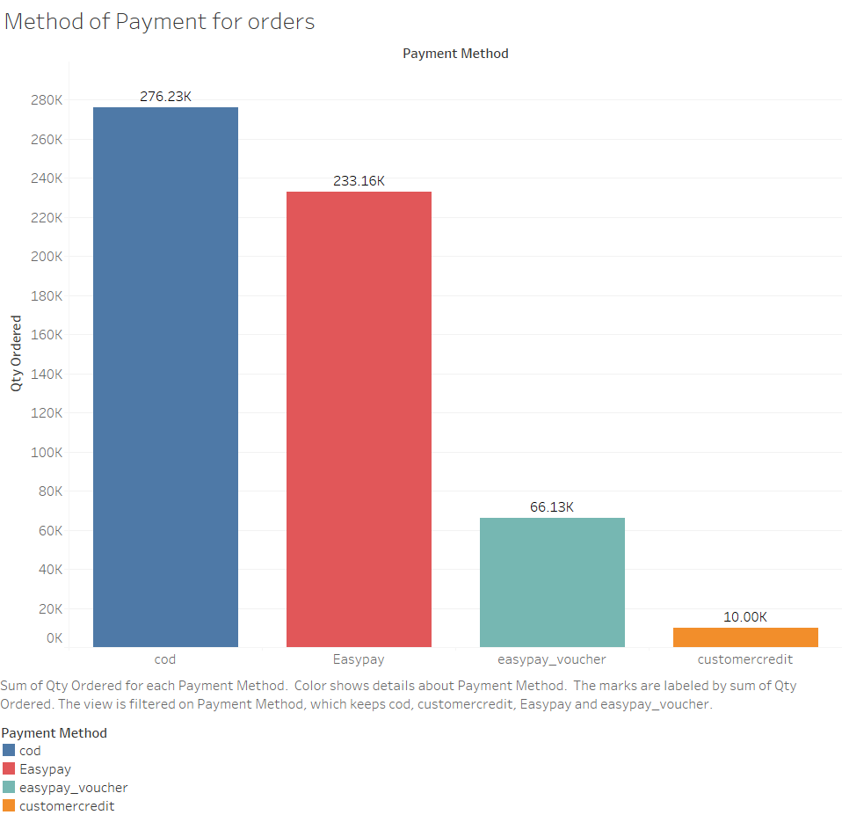
What is the highest used payment method?
COD (Cash on Delivery) is the highest used payment methods across the US States.
276.23K orders are placed using COD.
It is followed by EasyPay.

Slide 8
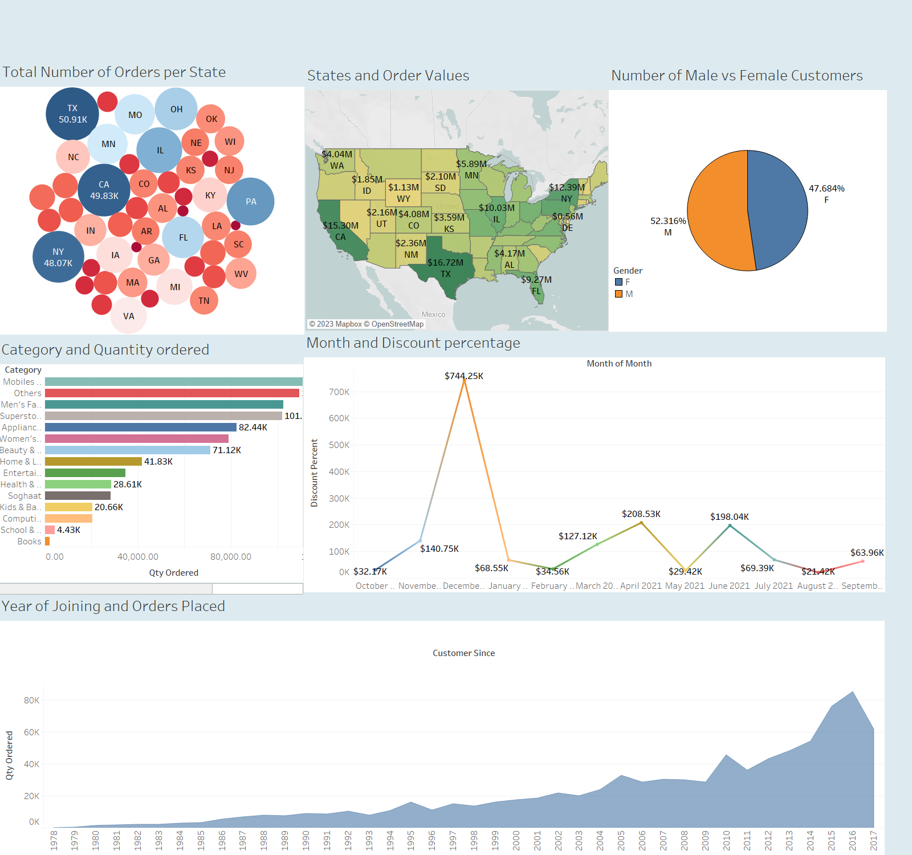
Dashboard from TABLEAU

Slide 9
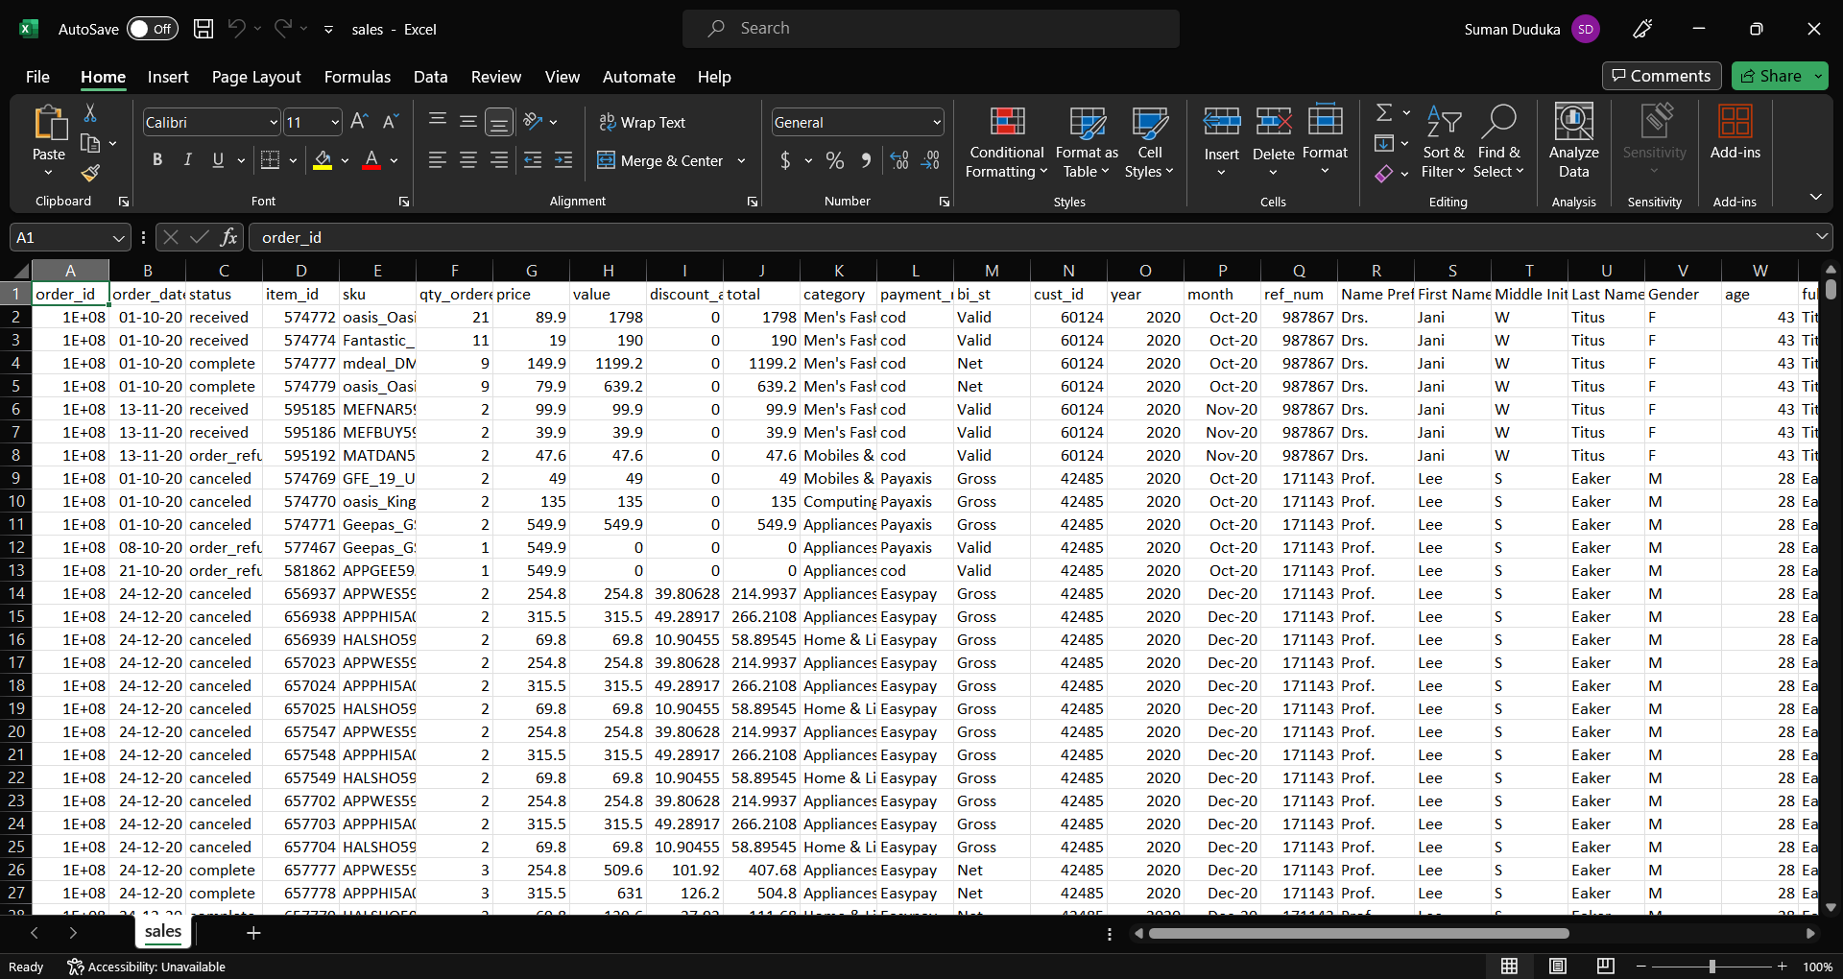
Excel File

Slide 10

End Notes
The visualizations and insights from this analysis will help in designing an effective online sales strategy for the U.S. market. By focusing on high-performing states like Texas, California, and New York and prioritizing mobile phones (a top-selling category), businesses can maximize revenue. Additionally, offering a cash-on-delivery option in these regions can further boost sales by catering to customer preferences.

